Slide 1


<Name>
<Date>

Slide 2

Outline
Executive Summary
Introduction
Methodology
Results
Conclusion
Appendix

Slide 3
Executive Summary
Summary of methodologies
In this project, we followed a structured approach to collect, process, analyze SpaceX launch data, And train a model which predict if the falcon 9 rocket first stage will land
Summary of all results
-Data Collection: Fetched SpaceX launch data via API and exported to CSV.
-Data Preprocessing: Cleaned, transformed, and handled missing values.
-EDA: Conducted descriptive statistics and visualizations; identified key insights.
-Model Training: Trained various models; SVM selected as the best-performing model.
-Model Performance: SVM optimized using GridSearchCV with 10-fold cross-validation.
-Conclusion: Summarized findings and suggested future improvements.

Slide 4
Introduction
Space X advertises falcon 9 rocket launches on its website with a cost of 62 million dollars; other providers cost upward of 165 million dollars each, much of the savings is because space X can reuse the first stage. Therefore if we can determine if the first stage will land, we can determine the cost of a launch. This information can be used if an alternate company wants to bid against space X for a rocket launch.
we aim to answer the following questions:
What are the most significant factors affecting the success of SpaceX launches?
How can we preprocess and analyze the data to extract meaningful insights?
Which machine learning model provides the best performance in predicting launch outcomes?
How can we optimize the selected model to achieve the highest accuracy and reliability?

Slide 5

Section 1

Slide 6
Methodology
Data Collection
The data collection process for this project involved fetching SpaceX launch data from the SpaceX API. The following steps outline the process:
API Endpoint: Identify the SpaceX API endpoint that provides launch data.
Parameters: Define the parameters for the API request, such as date range and launch status.
HTTP Request: Use an HTTP GET request to fetch the data from the API.
Data Storage: Store the fetched data in a JSON format.
Export to CSV: Convert the JSON data to a CSV file for further analysis.

Slide 7
Data Collection – SpaceX API
Data Collection Process
-API Integration: A request is made to the SpaceX API endpoint to fetch launch data.
_Data Retrieval: The API returns a JSON response containing detailed information on past launches.
-Parsing the JSON Response: Extracting key fields such as launch date, rocket type, payload mass, launch site, and landing outcome.
-Data Structuring: The extracted data is transformed into a structured format (such as a Pandas DataFrame) for further analysis.
-Preprocessing: Handling missing values, normalizing data, and ensuring consistency for the next step
Flowchart Representation
Start → API Request → JSON Response → Extract Key Fields → Structure Data → Preprocess Data → Ready for Analysis → End
GITHUB LINK:
https://github.com/ISM-O/DATA-SCIENCES-CAPSTONE-IBM.git

Slide 8
Data Collection - Scraping
Since not all information is available through the API, web scraping is performed to extract additional data from Wikipedia. The steps followed in this process include:
-Identifying the Target Webpage: Wikipedia’s List of Falcon 9 and Falcon Heavy launches page
-Sending an HTTP Request: Using Python's requests library to fetch the webpage content.
-Parsing the HTML Content: Using BeautifulSoup to extract tables containing launch records.
-Extracting Relevant Data: Retrieving launch dates, payload names, mission outcomes, and landing results.
-Data Cleaning and Structuring: Transforming the scraped data into a structured format, such as a Pandas DataFrame.
Flowchart Representation

Slide 9
Data Wrangling
Data Cleaning: Removing null values and correcting data types.
Transformation: Converting date formats and extracting relevant fields.
Handling Missing Values: Filling or removing missing values.
Normalization: Scaling numerical features to a standard range.
GITHUB URL :
https://github.com/ISM-O/DATA-SCIENCES-CAPSTONE-IBM.git

Slide 10
EDA with Data Visualization
Summarizing of what charts were plotted :
Bar Charts:
Purpose: To visualize the success rate of launches for different orbit types
Line Graphs:
Purpose: To observe the yearly trend of launch success rates.
Scatter Plots:
Purpose: To identify relationships between different variables such as flight number, payload mass, and launch success.
Catplots:
Purpose: To visualize the relationship between categorical variables and launch success.
GITHUB URL :
https://github.com/ISM-O/DATA-SCIENCES-CAPSTONE-IBM.git

Slide 11
EDA with SQL
Summary of SQL Queries Performed
Task 1: Display the names of the unique launch sites in the space mission.
Task 2: Display 5 records where launch sites begin with the string 'CCA’.
Task 3: Display the total payload mass carried by boosters launched by NASA (CRS).
Task 4: Display average payload mass carried by booster version F9 v1.1.
Task 5: List the date when the first successful landing outcome in ground pad was achieved.
Task 6: List the names of the boosters which have success in drone ship and have payload mass greater than 4000 but less than 6000.
Task 7: List the total number of successful and failure mission outcomes.
Task 8: List the names of the booster_versions which have carried the maximum payload mass. Use a subquery.

Slide 12
Task 9: List the records which will display the month names, failure landing outcomes in drone ship, booster versions, launch site for the months in year 2015.
Task 10: Rank the count of landing outcomes (such as Failure (drone ship) or Success (ground pad)) between the date 2010-06-04 and 2017-03-20, in descending order.
GITHUB URL :
https://github.com/ISM-O/DATA-SCIENCES-CAPSTONE-IBM.git

Slide 13
Build an Interactive Map with Folium
Launch Sites Locations Analysis with Folium
Map with Markers and Circles:
Purpose: To visualize the geographical locations of SpaceX launch sites.
Usage: Folium was used to create an interactive map with markers and circles indicating the locations of launch sites. This helps in understanding the spatial distribution of the launch sites and their proximities to various geographical features.
Marker Clusters:
Purpose: To manage overlapping markers for multiple launches at the same site.
Usage: Marker clusters were used to group multiple markers at the same location, making the map more readable and interactive.

Slide 14
Distance Calculation and PolyLines:
Purpose: To calculate and visualize the distances between launch sites and nearby geographical features (e.g., coastlines, cities).
Usage: Lines were drawn between launch sites and selected points of interest to show the distances, providing insights into the strategic placement of launch sites.

Slide 15
Build a Dashboard with Plotly Dash
Summary of Plots/Graphs and Interactions Added to the Dashboard
Dropdown for Launch Site Selection: This interaction allows users to filter the data based on specific launch sites, providing a more focused analysis of each site's performance.
Pie Chart for Total Successful Launches: The pie chart provides a clear visual representation of the success rate of launches at different sites, helping users quickly grasp the performance distribution.
Range Slider for Payload Mass Selection: The range slider enables users to filter the data based on payload mass, allowing for a more detailed analysis of how payload mass affects launch success.
Scatter Plot for Payload vs. Launch Success: The scatter plot helps in visualizing the correlation between payload mass and launch success, providing insights into how different payload masses and booster versions impact the success rate.

Slide 16
Predictive Analysis (Classification)
Summary of Model Development Process
Model Building
Logistic Regression: Created a logistic regression model and used GridSearchCV to find the best hyperparameters.
Support Vector Machine (SVM): Created an SVM model and used GridSearchCV to find the best hyperparameters.
Decision Tree: Created a decision tree model and used GridSearchCV to find the best hyperparameters.
K-Nearest Neighbors (KNN): Created a KNN model and used GridSearchCV to find the best hyperparameters.

Slide 17
Model Evaluation
Accuracy Calculation: Calculated the accuracy of each model on the test data.
Confusion Matrix: Plotted the confusion matrix for each model to evaluate performance in terms of true positives, false positives, true negatives, and false negatives.
Model Improvement
Hyperparameter Tuning: Used GridSearchCV to tune hyperparameters for each model to improve performance.
Cross-Validation: Used 10-fold cross-validation to ensure the model's performance is consistent across different subsets of the data.

Slide 18
Best Model Selection
Comparison: Compared the accuracy and confusion matrices of all models.
Best Model: Selected the model with the highest accuracy and best performance metrics as the final model.
GITHUB URL :
https://github.com/ISM-O/DATA-SCIENCES-CAPSTONE-IBM.git

Slide 19
Results
Predictive analysis results
The SVM model was selected as the best model based on its highest accuracy and best performance metrics

Slide 20

Section 2

Slide 21
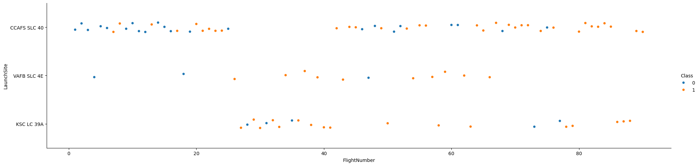
Flight Number vs. Launch Site
Scatter plot of Flight Number vs. Launch Site with hue indicating the launch outcome.

Slide 22
Explanation
X-Axis (Flight Number): Represents the sequential number of the flight.
Y-Axis (Launch Site): Represents the different launch sites used by SpaceX.
Hue (Class): Indicates the outcome of the launch (1 for success, 0 for failure).
Insight: Different launch sites have varying success rates over time, with some sites showing a higher frequency of successful launches.

Slide 23
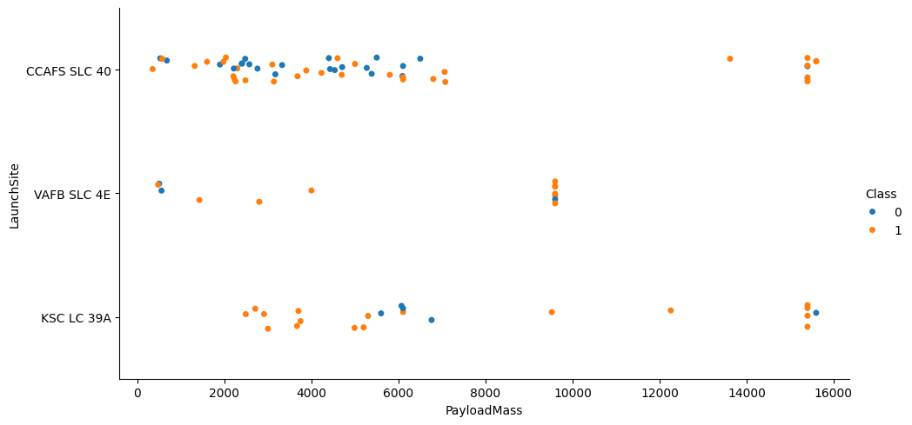
Payload vs. Launch Site
Scatter Plot of Flight Number vs. Launch Site

Slide 24
Explanation
X-Axis (Payload Mass (kg)): Represents the mass of the payload in kilograms.
Y-Axis (Launch Site): Represents the different launch sites used by SpaceX.
Hue (Class): Indicates the outcome of the launch (1 for success, 0 for failure).
Insight: Certain launch sites handle heavier payloads more successfully than others.
for the VAFB-SLC launchsite there are no rockets launched for heavypayload mass(greater than 10000).

Slide 25
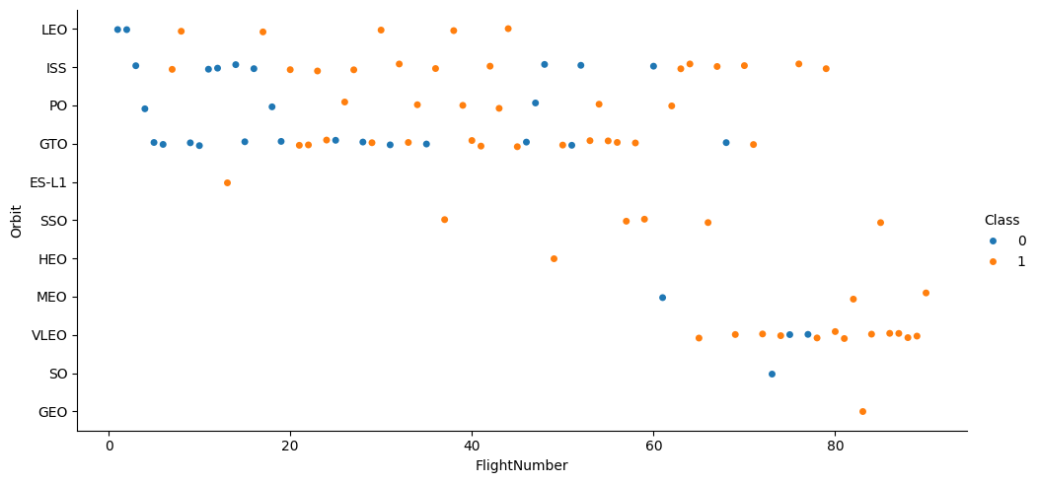
Flight Number vs. Orbit Type
Scatter Plot of Flight Number vs. Orbit Type

Slide 26
Explanation
X-Axis (Flight Number): Represents the sequential number of the flight.
Y-Axis (Orbit Type): Represents the different types of orbits used by SpaceX.
Hue (Class): Indicates the outcome of the launch (1 for success, 0 for failure).
Insight: Success rates in LEO orbit appear to be related to the number of flights, while GTO orbit shows no clear relationship

Slide 27
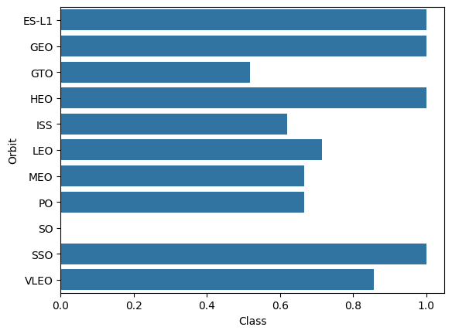
Success Rate vs. Orbit Type
Bar Chart for the Success Rate of Each Orbit Type

Slide 28
Explanation
X-Axis (Orbit Type): Represents the different types of orbits used by SpaceX.
Y-Axis (Success Rate): Represents the success rate of launches for each orbit type.
Insight: Orbits like ES-L1, GEO, HEO, and SSO have the highest success rates, while GTO and ISS have lower success rates

Slide 29
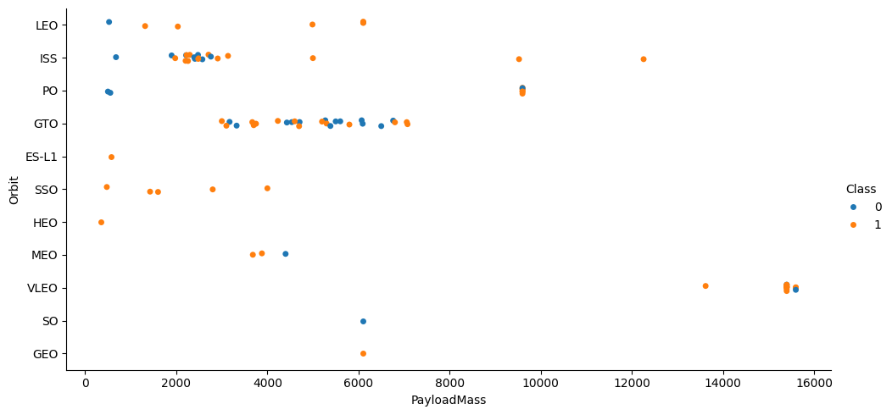
Payload vs. Orbit Type
Scatter Plot of Payload vs. Orbit Type

Slide 30
Explanation
X-Axis (Payload Mass (kg)): Represents the mass of the payload in kilograms.
Y-Axis (Orbit Type): Represents the different types of orbits used by SpaceX.
Hue (Class): Indicates the outcome of the launch (1 for success, 0 for failure).
Insight: Heavier payloads tend to have higher success rates in orbits like Polar, LEO, and ISS.

Slide 31
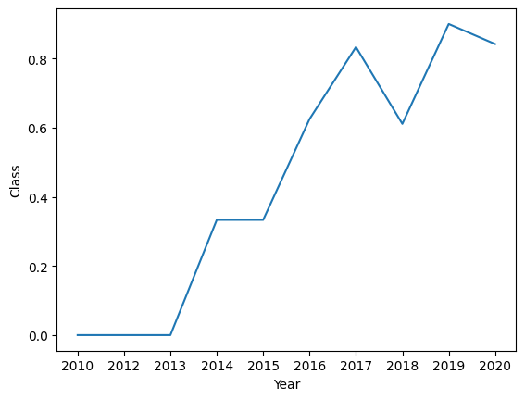
Launch Success Yearly Trend
Line Chart of Yearly Average Success Rate
Explanation
X-Axis (Year): Represents the year of the launch.
Y-Axis (Average Success Rate): Represents the average success rate of launches for each year.
Insight: The success rate has generally increased over the years, particularly after 2015.

Slide 32
All Launch Site Names
QUERY
SELECT DISTINCT Launch_Site FROM SPACEXTABLE;
Output
Launch_Site
CCAFS LC-40
VAFB SLC-4E
KSC LC-39A
CCAFS SLC-40

Slide 33
Explanation
The query SELECT DISTINCT Launch_Site FROM SPACEXTABLE; retrieves the unique launch sites from the SpaceX dataset. The result shows four unique launch sites:
CCAFS LC-40: Cape Canaveral Air Force Station Launch Complex 40
VAFB SLC-4E: Vandenberg Air Force Base Space Launch Complex 4E
KSC LC-39A: Kennedy Space Center Launch Complex 39A
CCAFS SLC-40: Cape Canaveral Air Force Station Space Launch Complex 40

Slide 34
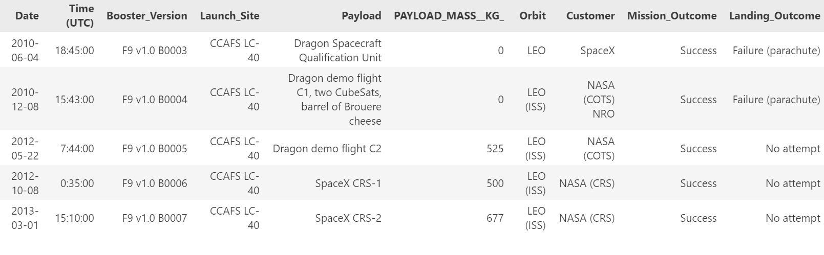
Launch Site Names Begin with 'CCA'
QUERY
SELECT * FROM SPACEXTABLE WHERE Launch_Site LIKE 'CCA%' LIMIT 5;
Output

Slide 35
Explanation
The query SELECT * FROM SPACEXTABLE WHERE Launch_Site LIKE 'CCA%' LIMIT 5; retrieves 5 records from the SpaceX dataset where the launch site begins with 'CCA'. The result shows the following records:

Slide 36
Average Payload Mass by F9 v1.1
QUERY
SELECT AVG(Payload_Mass_KG) AS Average_Payload_Mass FROM SPACEXTABLE WHERE Booster_Version = 'F9 v1.1’;
Output
Average_Payload_Mass
2928.4

Slide 37
Explanation
The query SELECT AVG(Payload_Mass_KG) AS Average_Payload_Mass FROM SPACEXTABLE WHERE Booster_Version = 'F9 v1.1'; calculates the average payload mass carried by the booster version F9 v1.1. The result shows that the average payload mass for this booster version is approximately 2928.4 kg.

Slide 38
First Successful Ground Landing Date
Find the dates of the first successful landing outcome on ground pad
Present your query result with a short explanation here

Slide 39
Successful Drone Ship Landing with Payload between 4000 and 6000
QUERY
SELECT Booster_Version FROM SPACEXTABLE
WHERE Landing_Outcome = 'Success (drone ship)'
AND Payload_Mass_KG BETWEEN 4000 AND 6000;
Output
Booster_Version
F9 FT B1022.1
F9 FT B1026.1
F9 FT B1029.1
F9 FT B1031.1
F9 FT B1035.1
Explanation
The query retrieves the names of boosters that have successfully landed on a drone ship and had a payload mass between 4000 and 6000 kg

Slide 40
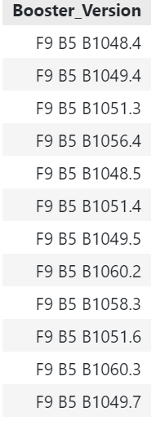
Boosters Carried Maximum Payload
QUERY
SELECT Booster_Version FROM SPACEXTABLE
WHERE Payload_Mass_KG = (SELECT MAX(Payload_Mass_KG) FROM SPACEXTABLE);
Output

Slide 41
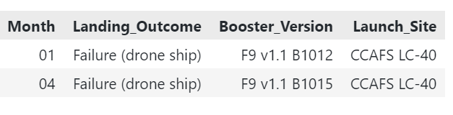
2015 Launch Records
QUERY
SELECT strftime('%m', Date) as Month, Booster_Version, Launch_Site,Landing_Outcome
FROM SPACEXTABLE WHERE Landing_Outcome ='Failure (drone ship)’ AND strftime('%Y', Date) = '2015’;
Output
Explanation
The query retrieves the names of the boosters that have carried the maximum payload mass
:

Slide 42
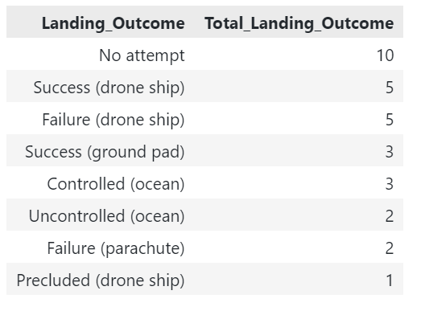
Rank Landing Outcomes Between 2010-06-04 and 2017-03-20
QUERY
SELECT Landing_Outcome, COUNT(Landing_Outcome) AS Total_Landing_Outcome FROM SPACEXTABLE
WHERE Date BETWEEN '2010-06-04' AND '2017-03-20'
GROUP BY Landing_Outcome ORDER BY Total_Landing_Outcome DESC;
Output

Slide 43
Explanation
The query ranks the count of landing outcomes between the specified dates in descending order.

Slide 44

Section 3

Slide 45
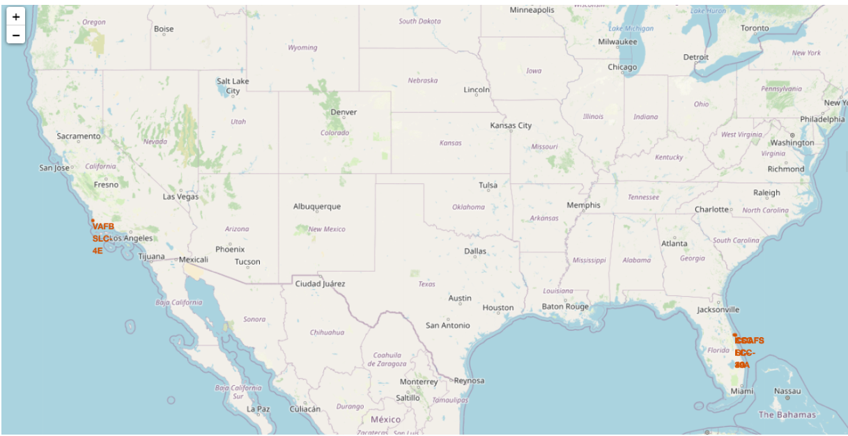
<Folium Map Screenshot 1>
Map with all launch sites marked

Slide 46
Explanation of the Important Elements and Findings
The generated Folium map displays the locations of all SpaceX launch sites around the world. Each marker on the map represents a launch site, and clicking on a marker will display the name of the launch site. The map provides a global view of SpaceX's launch infrastructure, highlighting the geographical distribution of their launch sites. This visualization helps in understanding the strategic placement of launch sites for optimal coverage and accessibility.

Slide 47
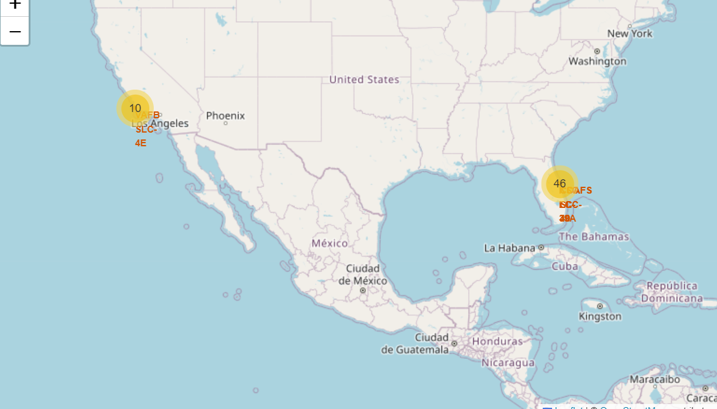
<Folium Map Screenshot 2>
the Folium Map with Color-Labeled Launch Outcomes

Slide 48
Explanation of the Important Elements and Findings on the Screenshot
The generated Folium map displays the locations of all SpaceX launch sites with color-labeled markers indicating the launch outcomes. Each marker on the map represents a launch site, and the color of the marker indicates the outcome of the launches from that site:
Green: Successful launches
Red: Failed launches
Blue: Other outcomes (e.g., no attempt)
Clicking on a marker will display the name of the launch site. The map provides a visual representation of the success and failure rates of launches from different sites, highlighting the performance and reliability of each launch site. This visualization helps in understanding the geographical distribution of successful and failed launches, which can be useful for further analysis and decision-making.

Slide 49
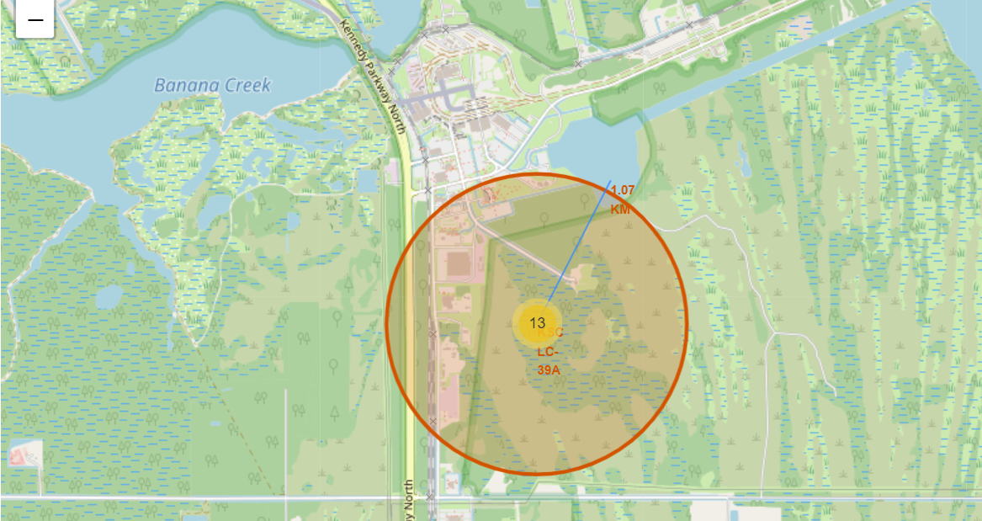
<Folium Map Screenshot 3>
Folium Map with Proximities and Distances

Slide 50
Explanation of the Important Elements and Findings on the Screenshot
The generated Folium map displays the selected launch site along with its proximities such as railway, highway, and coastline. Each marker on the map represents a point of interest, and clicking on a marker will display the name and distance from the selected launch site. The map provides a visual representation of the geographical context of the launch site, highlighting its accessibility and potential logistical considerations.
Blue Marker: Represents the selected launch site.
Purple Markers: Represent proximities such as railway, highway, and coastline, with distances calculated and displayed in the popup.
This visualization helps in understanding the strategic placement of the launch site in relation to important infrastructure, which can be useful for planning and operational purposes.

Slide 51

Section 4

Slide 52
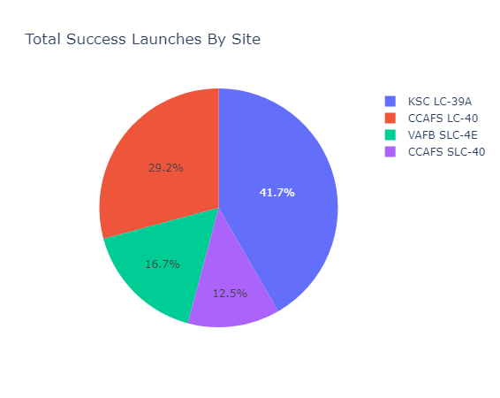
<Dashboard Screenshot 1>
Launch Success Count for All Sites

Slide 53
Explanation of the Important Elements and Findings
The generated dashboard displays a pie chart showing the total successful launches count for all SpaceX launch sites. The pie chart provides a visual representation of the distribution of successful launches across different launch sites.
Pie Chart: Represents the proportion of successful launches for each launch site.
Dropdown Menu: Allows the user to filter the pie chart by selecting a specific launch site or viewing data for all sites.
Title: "Total Success Launches By Site" indicates the purpose of the pie chart.
This visualization helps in understanding the performance of different launch sites in terms of successful launches, highlighting the sites with the highest success rates. This information can be useful for analyzing the reliability and efficiency of each launch site.

Slide 54
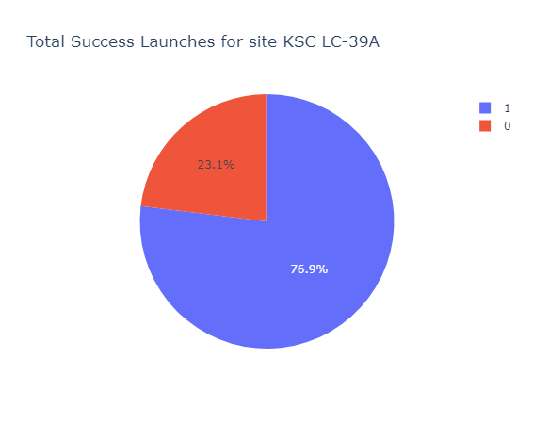
<Dashboard Screenshot 2>
Pie Chart for the Launch Site with Highest Launch Success Ratio

Slide 55
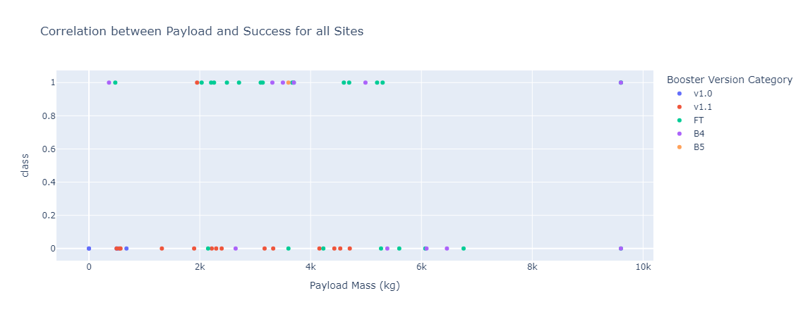
<Dashboard Screenshot 3>
the Scatter Plot for Payload vs. Launch Outcome

Slide 56
Explanation of the Important Elements and Findings
The generated dashboard displays a scatter plot showing the correlation between payload mass and launch outcome for all SpaceX launch sites. The scatter plot provides a visual representation of how different payload masses affect the success rate of launches.
Scatter Plot: Represents the relationship between payload mass and launch outcome, with different colors indicating different booster version categories.
Dropdown Menu: Allows the user to filter the scatter plot by selecting a specific launch site or viewing data for all sites.
Range Slider: Allows the user to select a range of payload masses to filter the scatter plot.
Title: "Correlation between Payload and Success for all Sites" indicates the purpose of the scatter plot.
This visualization helps in understanding the impact of payload mass on launch success rates, highlighting which payload ranges and booster versions have the highest success rates. For example, it may show that certain booster versions perform better with specific payload ranges, providing valuable insights for optimizing future launches.

Slide 57

Section 5

Slide 58
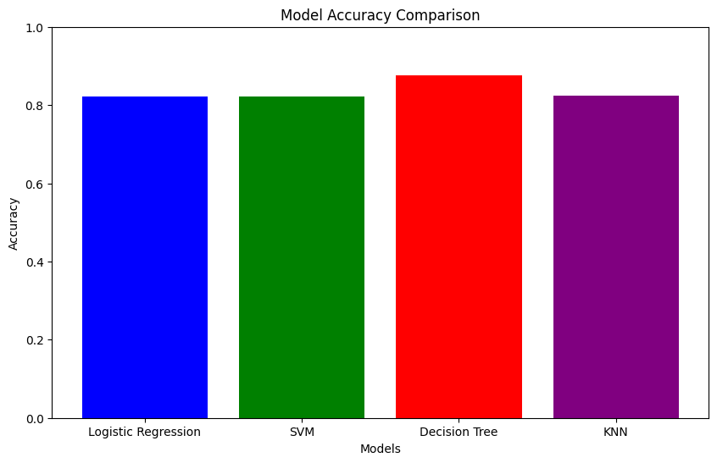
Classification Accuracy
Bar Chart: Represents the accuracy of each classification model.
X-axis: Lists the different classification models (Logistic Regression, SVM, Decision Tree, KNN).
Y-axis: Represents the accuracy scores of the models.
Title: "Model Accuracy Comparison" indicates the purpose of the chart.

Slide 59
From the bar chart, we can see that the SVM (Support Vector Machine) model has the highest classification accuracy among ther models tested. This indicates that the SVM model is the most effective in predicting the landing outcome of SpaceX Falcon 9 first stages based on the given data.

Slide 60
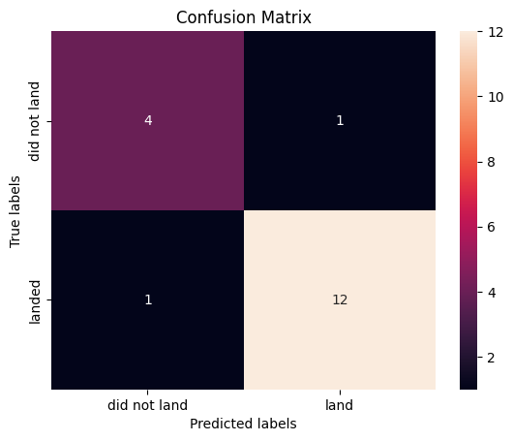
Confusion Matrix
Confusion Matrix of SVM (Support Machine Vector)

Slide 61
Explanation of the Important Elements and Findings on the Screenshot
The confusion matrix provides a detailed breakdown of the performance of the SVM model in predicting the landing outcome of SpaceX Falcon 9 first stages. It shows the number of correct and incorrect predictions made by the model, categorized by the actual and predicted classes.
True Positives (TP): The number of instances correctly predicted as the positive class.
True Negatives (TN): The number of instances correctly predicted as the negative class.
False Positives (FP): The number of instances incorrectly predicted as the positive class.
False Negatives (FN): The number of instances incorrectly predicted as the negative class.

Slide 62
Findings
Diagonal Elements: Represent the number of correct predictions (both TP and TN).
Off-Diagonal Elements: Represent the number of incorrect predictions (both FP and FN).
From the confusion matrix, we can observe the following:
The SVM model has a high number of true positives and true negatives, indicating that it is effective in correctly predicting both successful and unsuccessful landings.
The number of false positives and false negatives is relatively low, suggesting that the model has a good balance between sensitivity (recall) and specificity.
Overall, the confusion matrix confirms that the SVM model is the best-performing model in terms of classification accuracy and provides a clear visualization of its prediction performance.

Slide 63
Conclusions
This report presents the findings from the analysis and modeling of SpaceX Falcon 9 first stage landing outcomes. The analysis involved data wrangling, exploratory data analysis, visualization, and machine learning model evaluation. The primary goal was to predict the landing outcomes of SpaceX Falcon 9 first stages and identify factors contributing to successful landings.

Slide 64
Appendix
GITHUB URL :
https://github.com/ISM-O/DATA-SCIENCES-CAPSTONE-IBM.git
this repository contains the complete notebook with all the necessary code and results

Slide 65


